Slide 1
TESS: The Extraordinary Sudoku Solver
CSC-470 – Final Project Presentation
By Team #1: David Koval and Joseph Mammo

Slide 2
Outline
Introduction
Goals
Requirements
System Model | Design
System Implementation
System Testing | Conclusion
Demo

Slide 3
Introduction
The popularity of Sudoku puzzles has increased dramatically over the past decades.
(personal story)
(About TESS)
We focused on solving the regular 9x9 board.
(talk about our algorithm)

Slide 4
Goals*
Problems:
Allowing the user to play a classic 9x9 sudoku game.
Managing difficulty levels.
Providing hints and error checks to the user.
Successfully solving a given sudoku game under the customer’s time constraint.
Solutions:
Store existing puzzles in database based on difficulty.
Use DFS along with pruning to solve it within a reasonable time limit.

Slide 5
Requirements
Short intro

Slide 6
Requirements | Functional
ID: R1 – Play Game Option
1
ID:R2 – Select Difficulty
2
ID:R3 – Back Option
3
ID:R4 – Continue Game
4
ID:R5 – Get Puzzle
5
ID:R6 – Solver Option
6
ID:R7 – Input Sudoku Puzzle to Solve
7
ID:R8 – Check Current Board
8

Slide 7
Requirements | Functional
ID: R9 – Delete an Input Value
1
ID:R10 – Clear Board
2
ID:R11 – Solve Current Board
3
ID:R12 – Play Sudoku Game
4
ID:R13 – Hint Option
5
ID:R14 – Download Mobile Application
6

Slide 8
Requirements | Non-functional
ID: R1 – System Availability
1
ID:R3 – Search Algorithm
3
ID:R4 – Pruning Technique
4
ID:R5 – Database Storage
5
ID:R6 – Easy to Use
6
ID:R7 – Private Information
7
ID:R2 – Solve Time
2

Slide 9
System Design | Overview

Slide 10
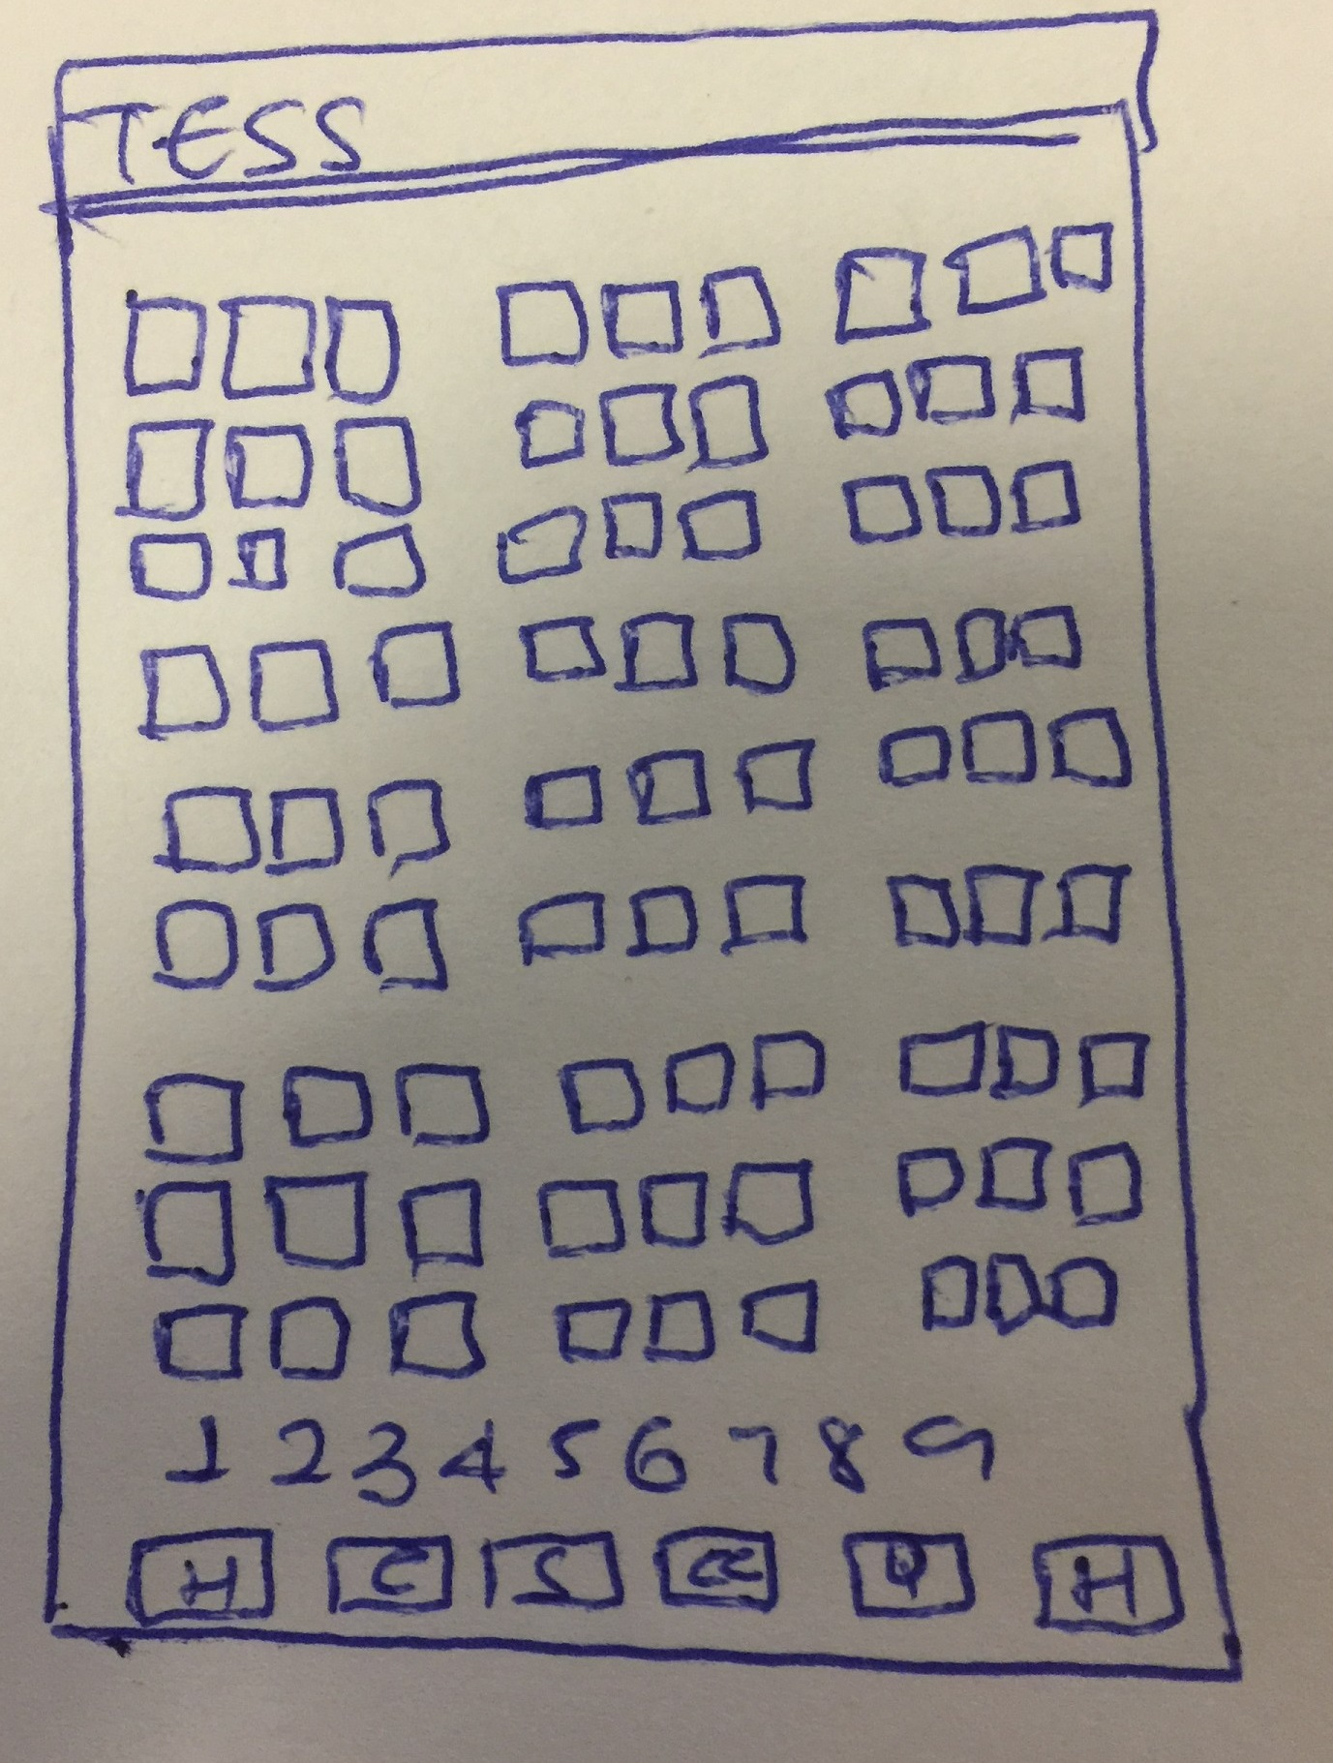
System Design | User Constraints
Explanation ..

Slide 11
System Design | System Constraints
ID:C1 – Memory Space
ID:C2 – Internet Connection for Updates
ID:C3 – Programming Language
ID:C4 – Android Device Only
ID:C5 – Time to Solve
ID:C6 – Database Usage

Slide 12
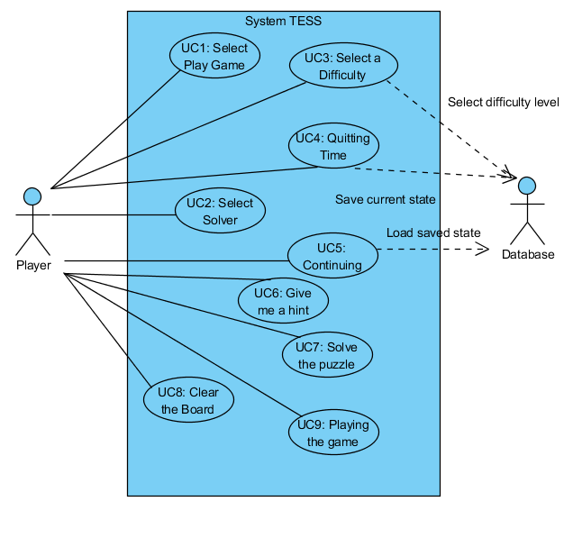
System Model | Use Case
Actors:
Player
Database
Use Cases:
ID:UC1
ID:UC2
ID:UC3
ID:UC4
ID:UC5 …

Slide 13
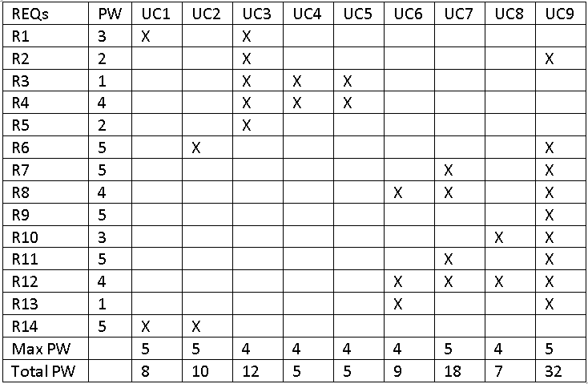
System Model | Traceability Matrix
Explanation ..

Slide 14
System Model | Prototyping
Explanation ..

Slide 15
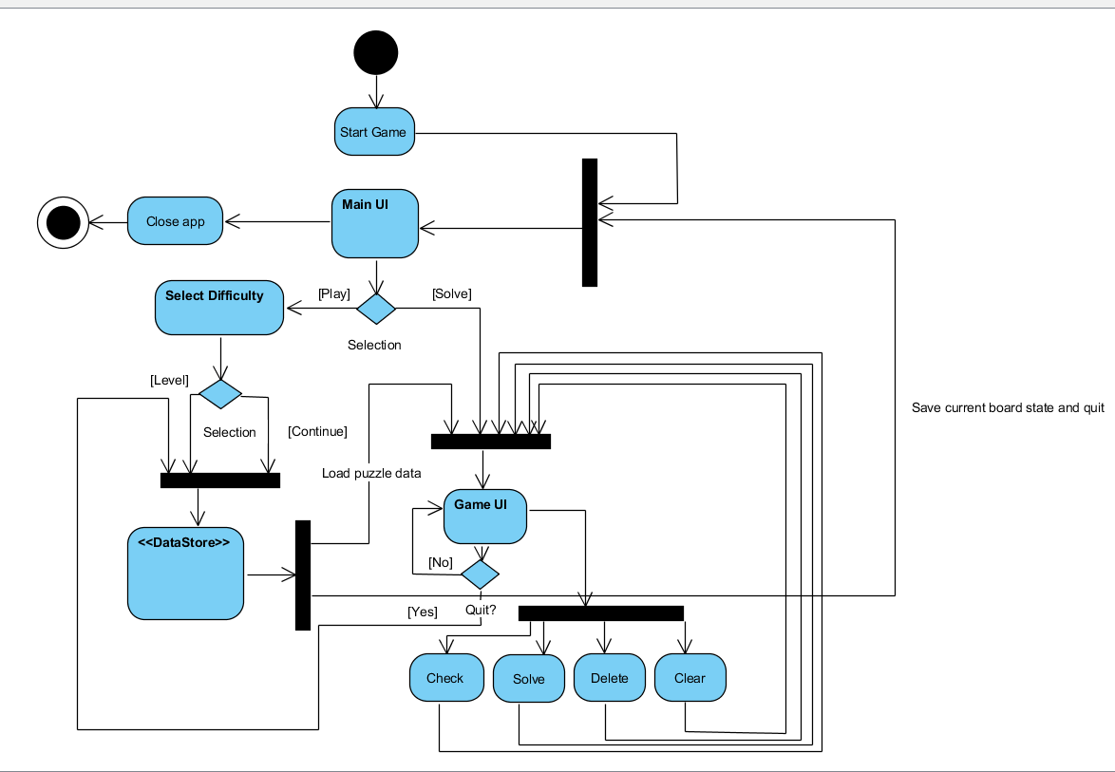
Alternative Designs | Activity Diagram
Explanation

Slide 16
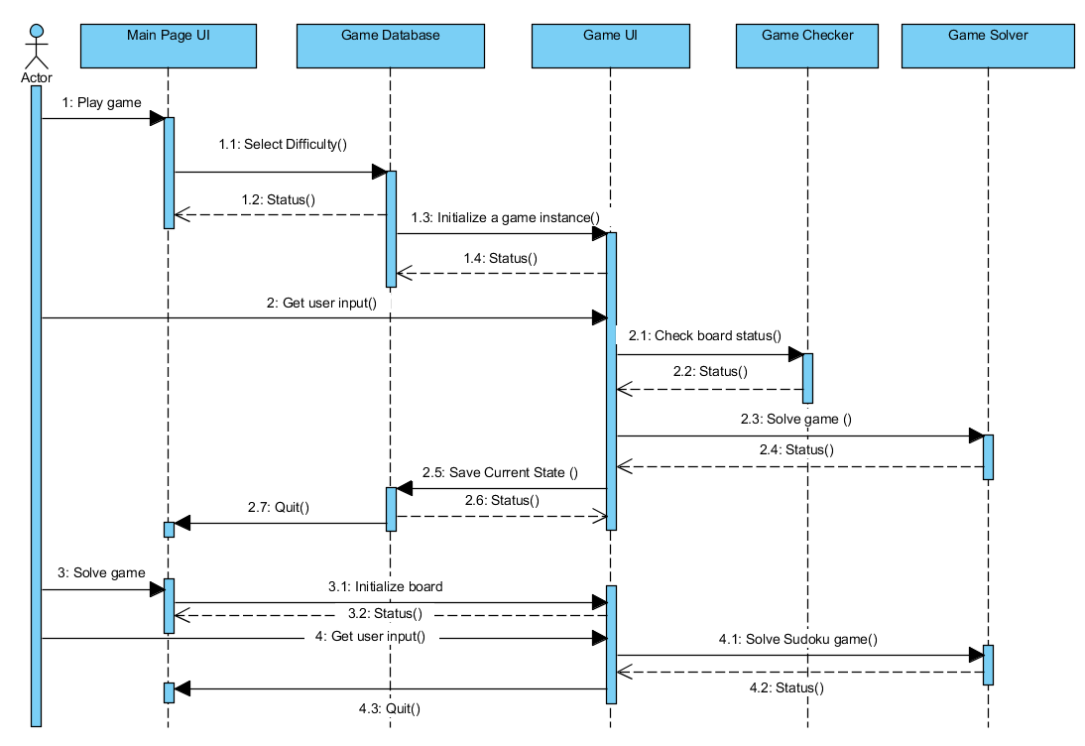
Alternative Designs | Sequence Diagram
Explanation ..

Slide 17
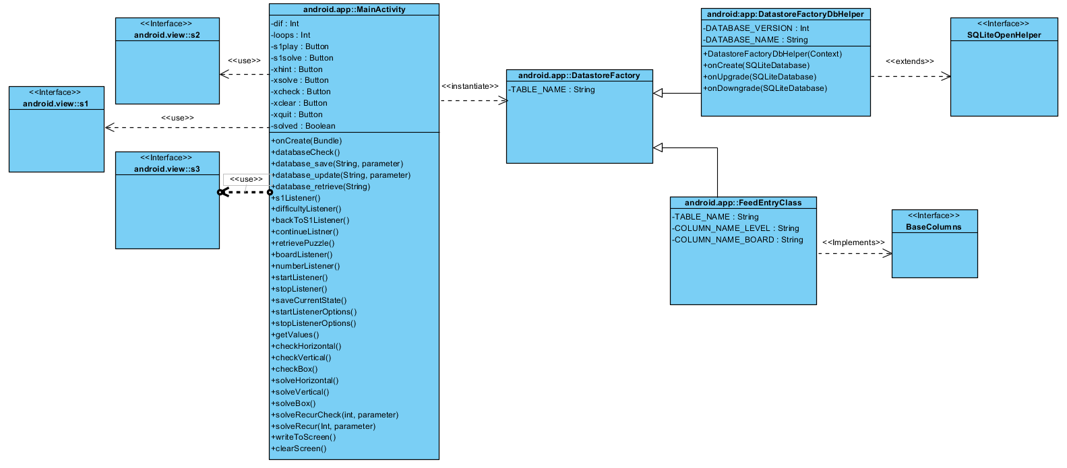
Alternative Designs | Class Diagram

Slide 18
Software Process Model
We are going to be using the Extreme Programming (XP) software process model.
Mainly implementing incremental development model
Full time customer engagement
Paired programming
Incrementally develop and get feedback from our alpha and beta testers (i.e. close friends and families).

Slide 19
System Implementation

Slide 20

Demo

Slide 21
System Testing

Slide 22
Conclusions

